Slide 1
NAP4 case review
Tim Cook

Slide 2
Phase 2 Inclusion Criteria?
Airway complication leading to
Death
Brain damage
Emergency surgical airway/ cricothyroidotomy
ICU admission due to airway management complication (or prolongation of ICU stay)
Notes:
These are the inclusion criteria,
-Death
-Brain damage
-Emergency surgical airway
-ICU admission resulting from an airway management complication
Airway problems with these endpoints are likely to be:
Difficult or failed ventilation (via facemask, airway or tracheal tube)
Difficult or failed intubation
Tracheal tube misplacement
CICV - the can’t intubate can’t ventilate scenario.

Slide 3
What is a serious complication?
Death and brain damage: by definition permanent harm
Other permanent harm: reviewing all patients admitted to ICU or undergoing emergency surgical airway
  not all will suffer permanent harm
  this will be useful information in its own right.
  we will capture the vast majority of patients suffering permanent harm from complications of airway management.

Slide 4
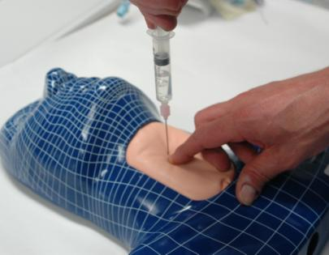
Emergency Surgical Airway
Includes
  Emergency Cricothyroidotomy
  Needle
  Cannula
  Emergency surgical airway
  Cricothyroidotomy
  Tracheostomy
Notes:
These procedures are considered to be inclusion criteria if performed as an emergency.
But NOT as planned procedures UNLESS death, Brain damage or complications resulting from management of the airway problem results in admission to HDU
A planned cannula cricothyroidotomy prior to induction of general anaesthesia for the management of a difficult airway is not an indication for inclusion unless a serious complication develops meeting one of the inclusion criteria

Slide 5
ICU admission: inclusion examples
  Post extubation stridor requiring re-intubation and ICU admission
  Elective ventilation following hypoxic cardiac arrest due to an airway problem during anaesthesia
  ICU admission following aspiration of gastric contents
Notes:
ICU admission needs some clarification. It must result from and airway management complication and must produce harm.
Here are some examples of cases for submission.

Slide 6
Airway problems elsewhere meeting inclusion criteria
  Anaesthetic
  anywhere in the hospital – Inform NAP4
  ICU – Inform NAP4
  Emergency Department – Inform NAP4
  Hospital wards - Do not inform NAP4
  Pre-hospital care - Do not inform NAP4
Notes:
We need to collect ALL events related to anaesthesia. These may occur outside theatre, in radiology or on the labour ward.
If 1/Death, 2/Brain damage, 3/an Emergency surgical airway or 4/ ICU admission resulting from an airway management complication in the Emergency Department we request notification.
If 1/Death, 2/Brain damage, 3/an Emergency surgical airway or 4/ Prolongation of ICU treatment results from an airway management complication occuring in the ITU or in an ITU patient, we request notification. An example might be an hypoxic brain insult due to cardiac arrest whilst changing a tracheal tube.
BUT because of the difficulty of assessing the contribution airway management makes to outcome in patients from the ED and ICU and due to a lack of a denominator these cases will be analysed but not used to calculate the incidence of complications.

Slide 7
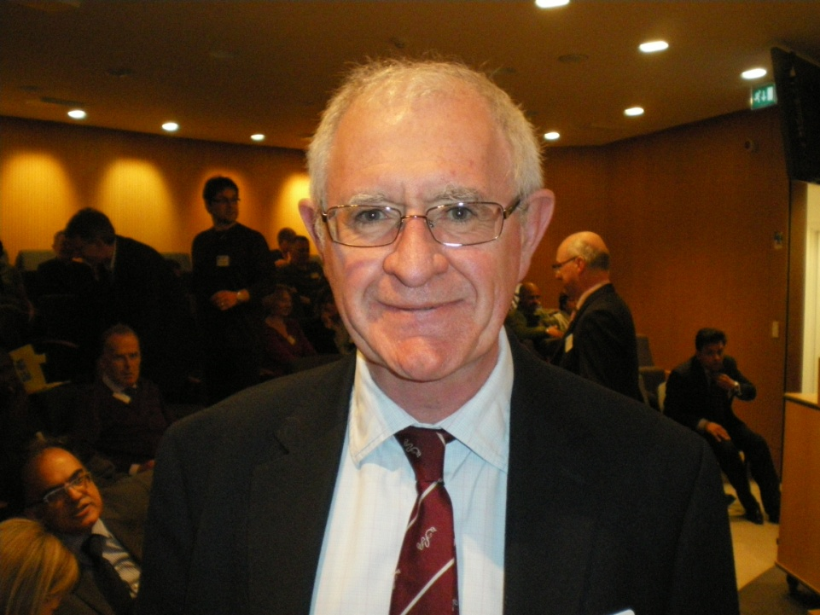
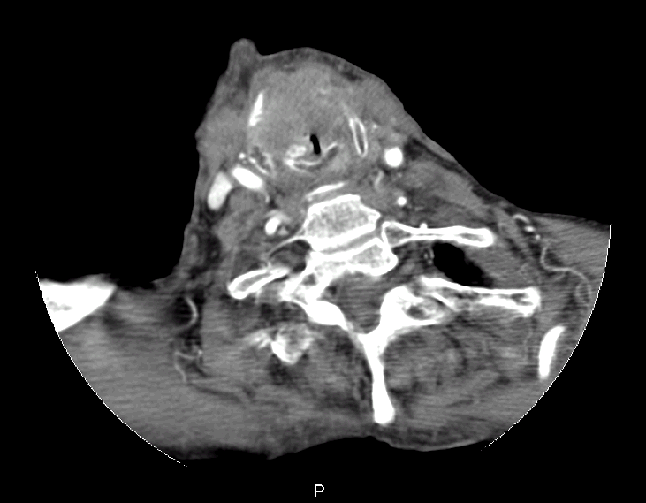
NAP4 moderator
  Cases of doubt?
  Ian Calder
  nap4moderator@rcoa.ac.uk
  Independent of all other processes

Slide 8
Phase 2: Airway Events
Secure process
Local reporter informs me of case
I confirm entry criteria met
NAP4 Username/password issued remotely
User required to change password in 1st access
Website informs me when case complete
Report to sent to Nick Woodall

Slide 9
Phase 2: Airway Events
Who knows what
TC
Where event reported from
When complete
No case details
NW
Case details
Not source or site

Slide 10
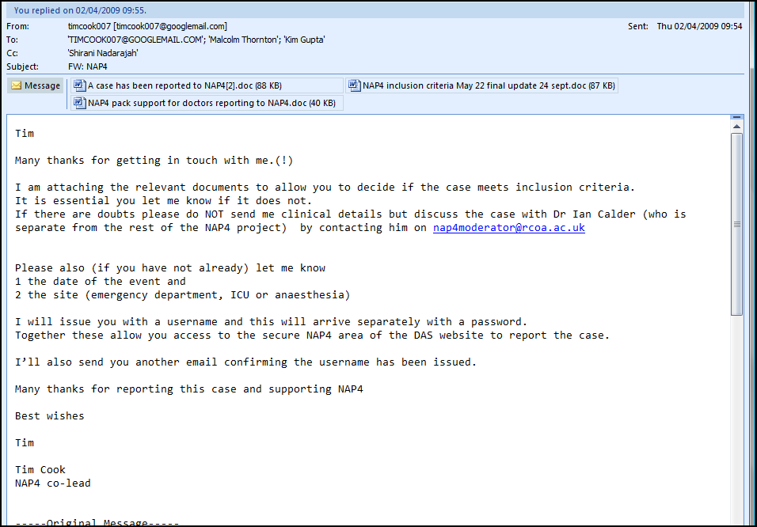
Notification

Slide 11
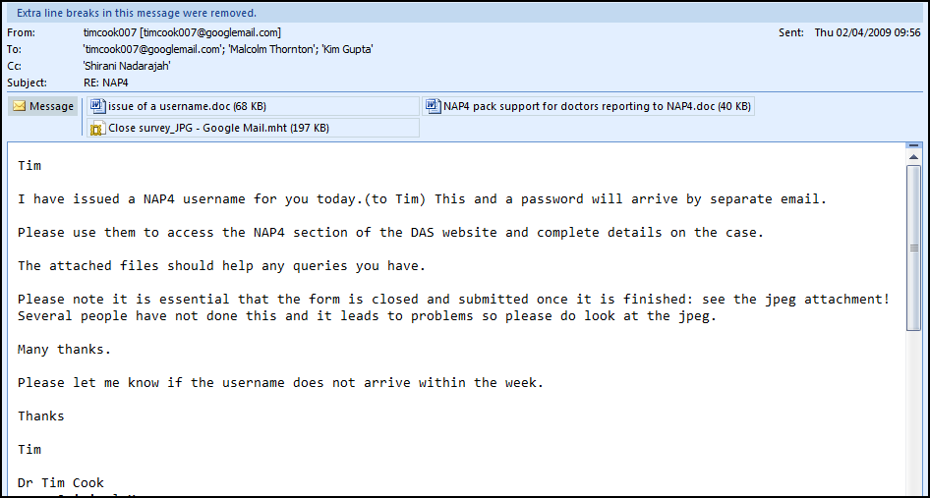
Username issue

Slide 12

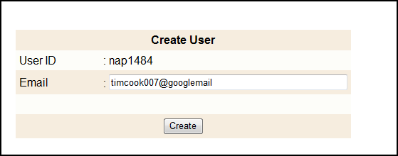

Slide 13
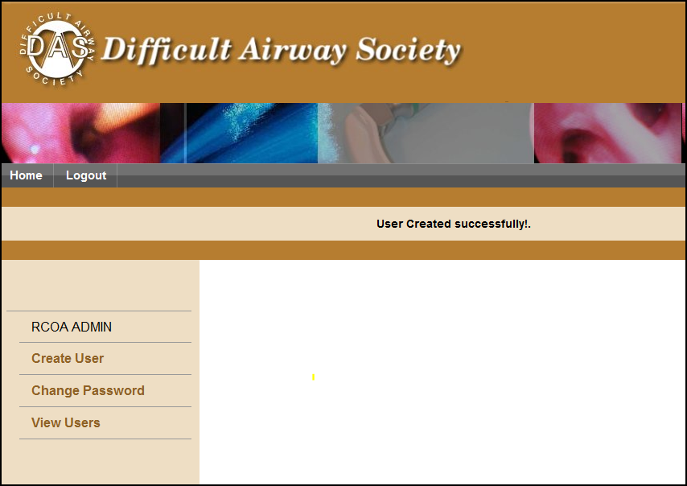

Slide 14
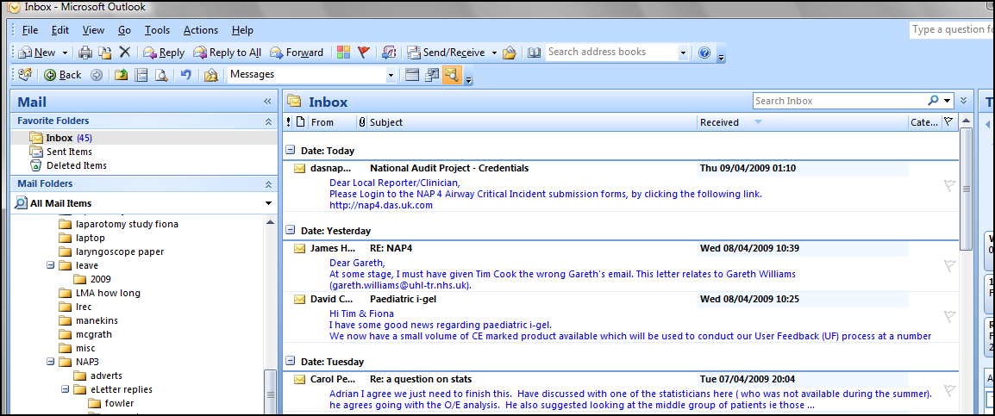
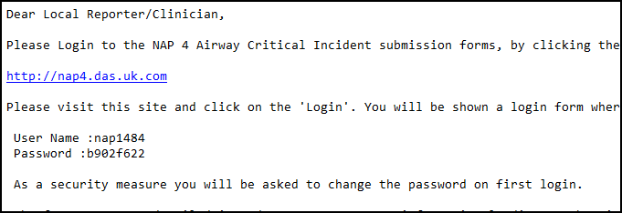

Slide 15
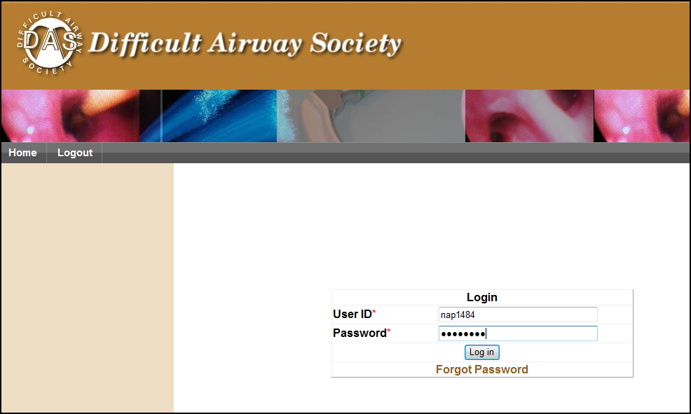

Slide 16
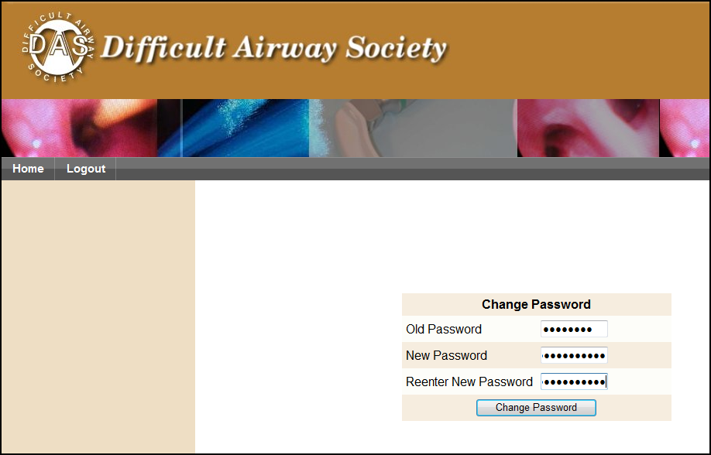

Slide 17
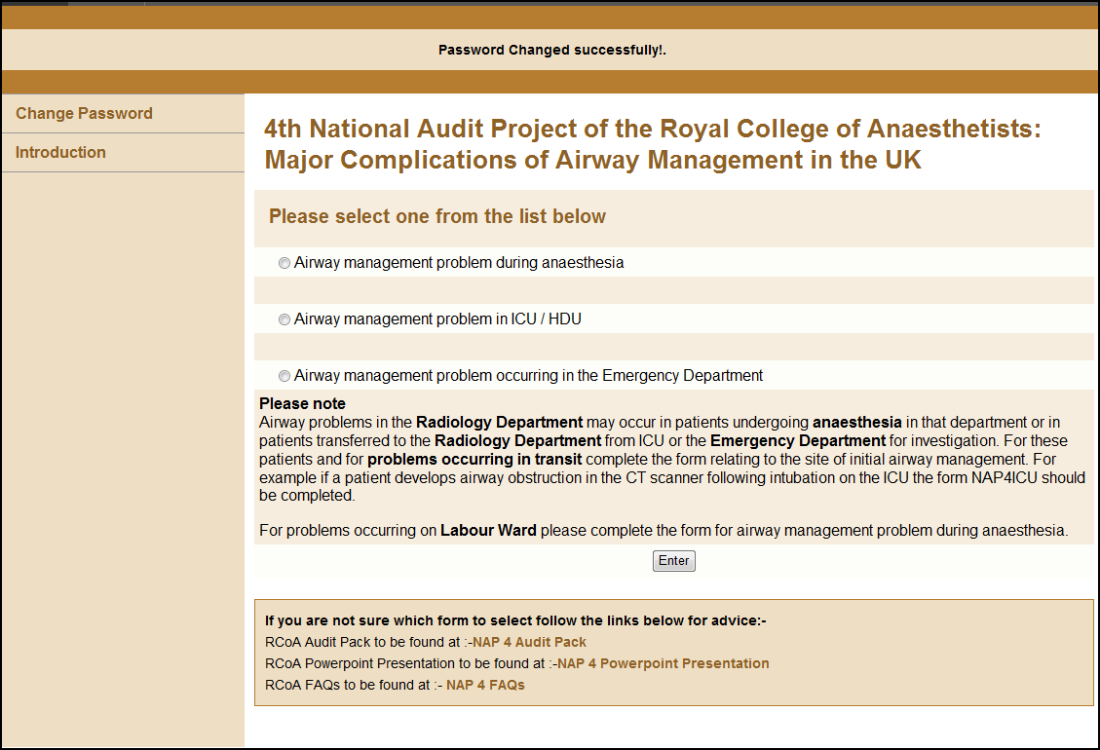

Slide 18
On-line Data Submission
Structured questionnaire
  Designed for common clinical scenarios
  Some clinical presentations do not fit in well
  Acts as an aide memoire for the LR
  Feeds an Excel spreadsheet
  Output is dependent on the input
Free text

Slide 19
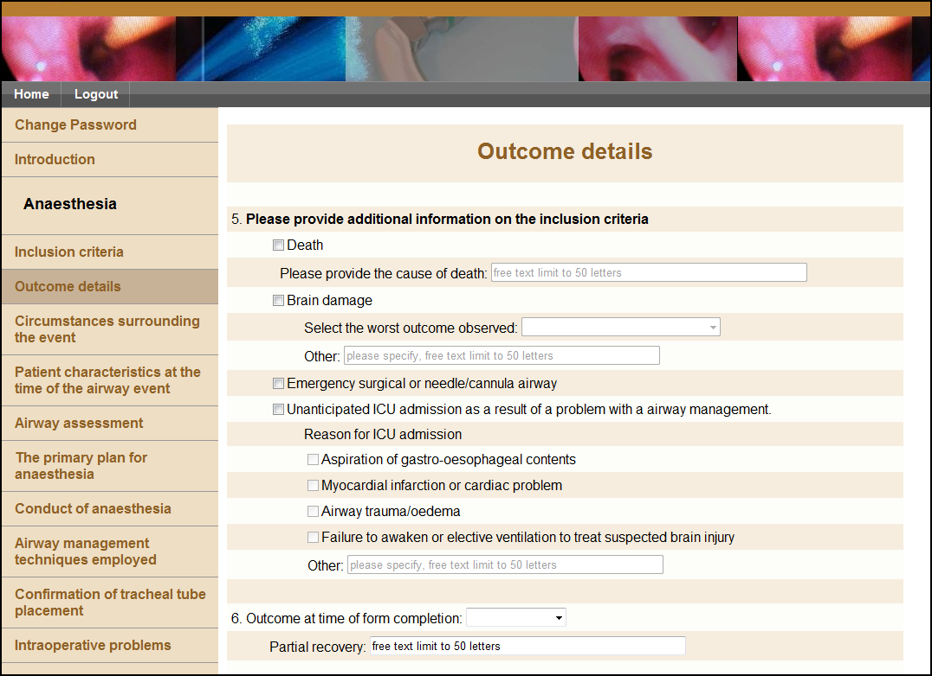

Slide 20
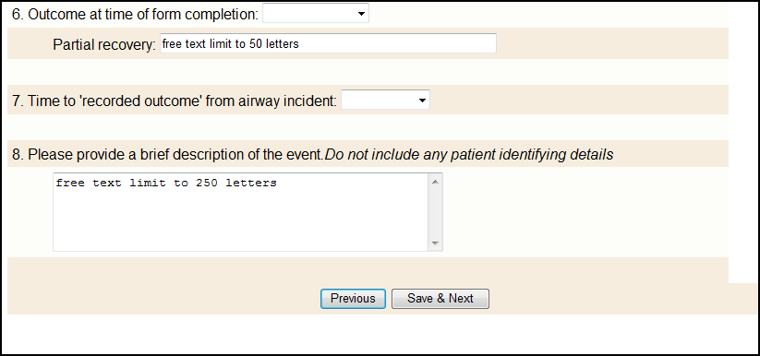

Slide 21
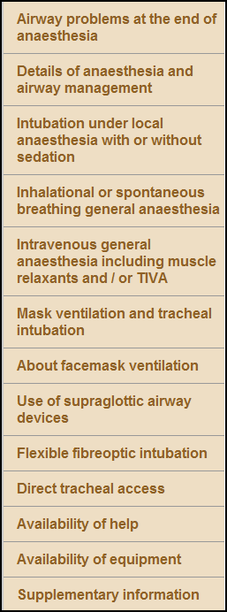
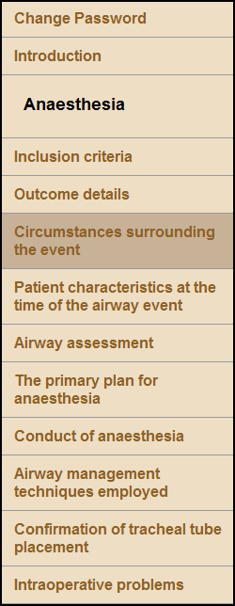

Slide 22
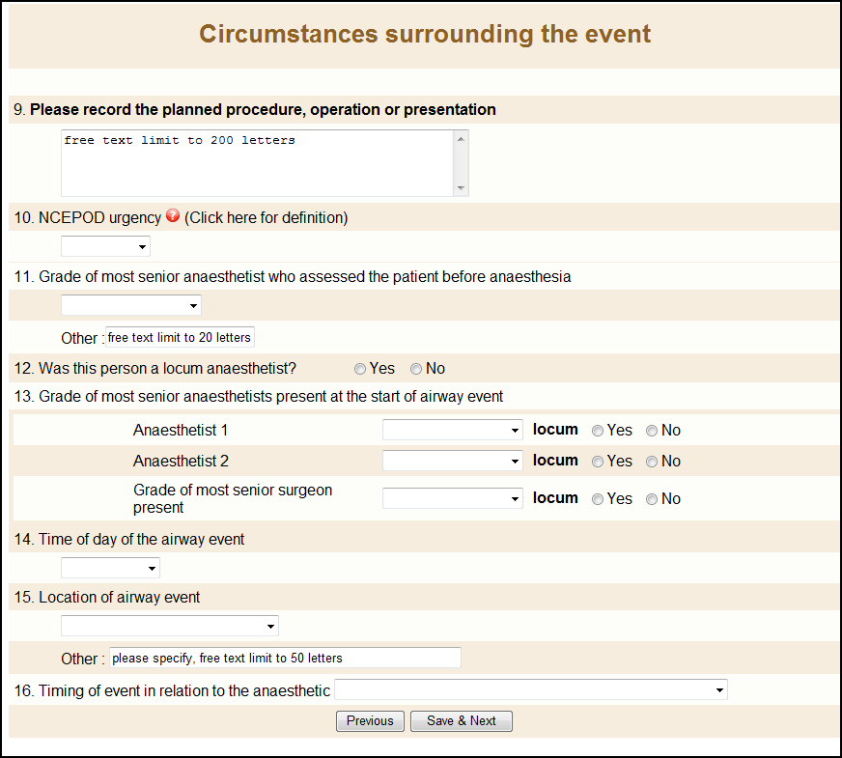

Slide 23
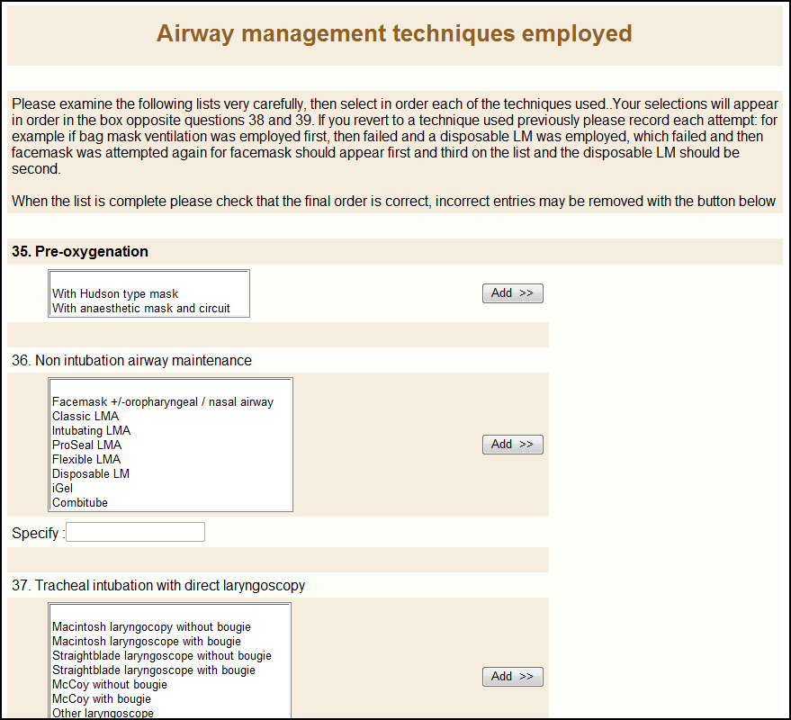

Slide 24
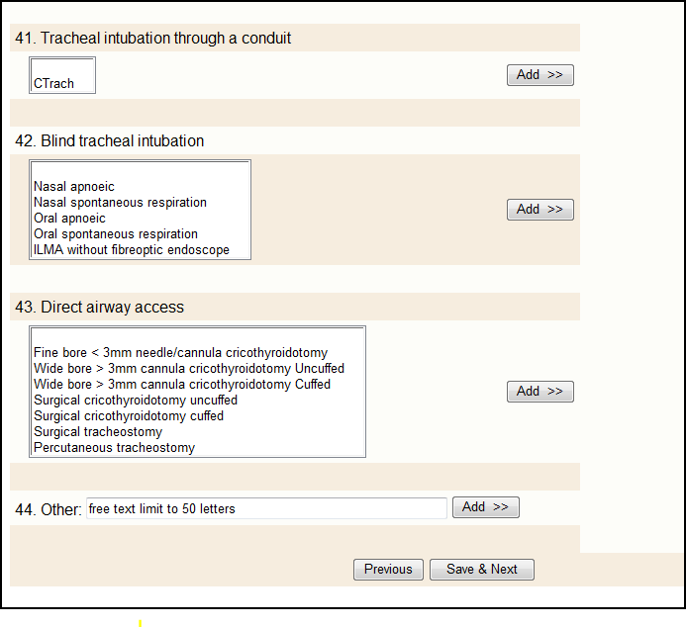

Slide 25
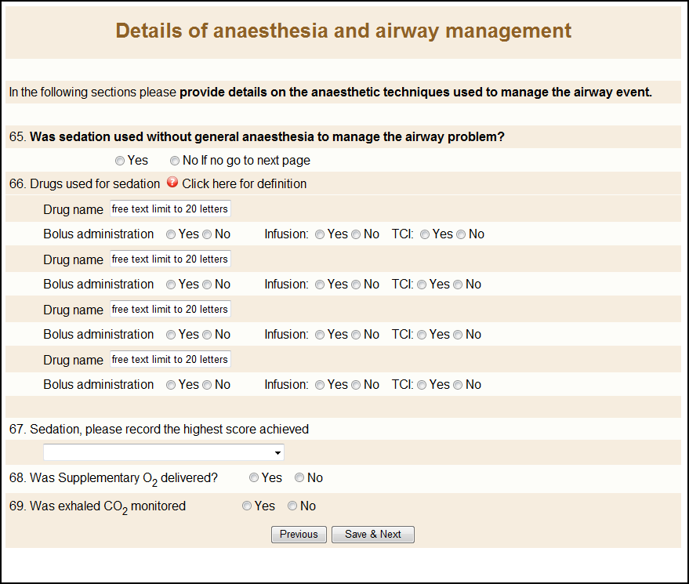

Slide 26
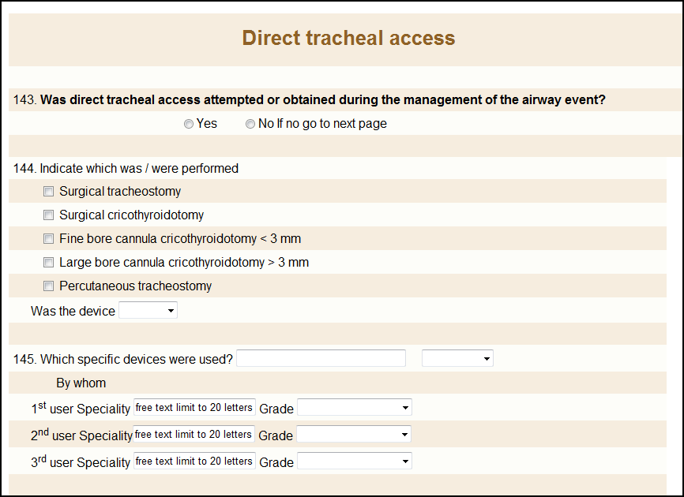

Slide 27
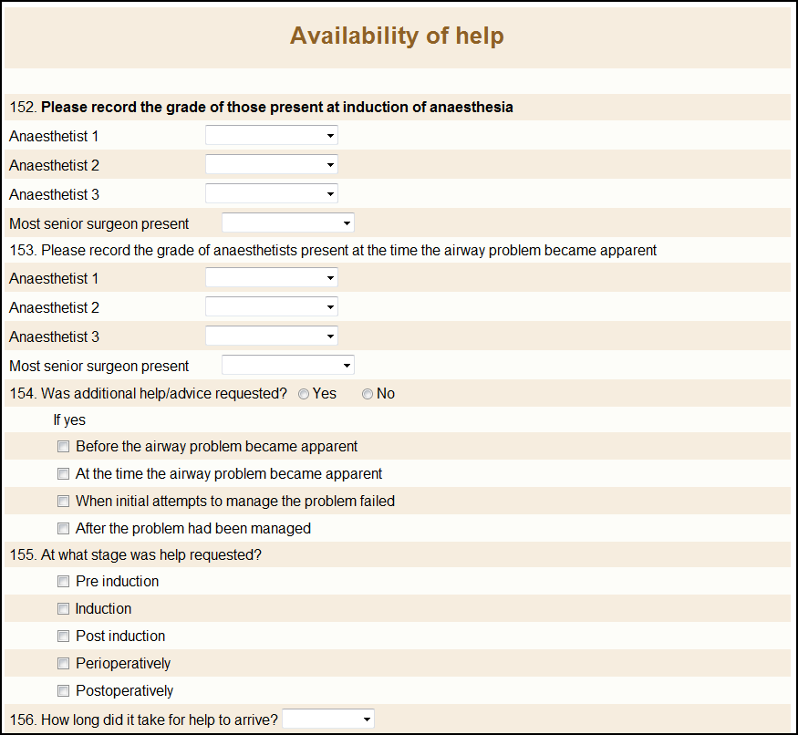

Slide 28
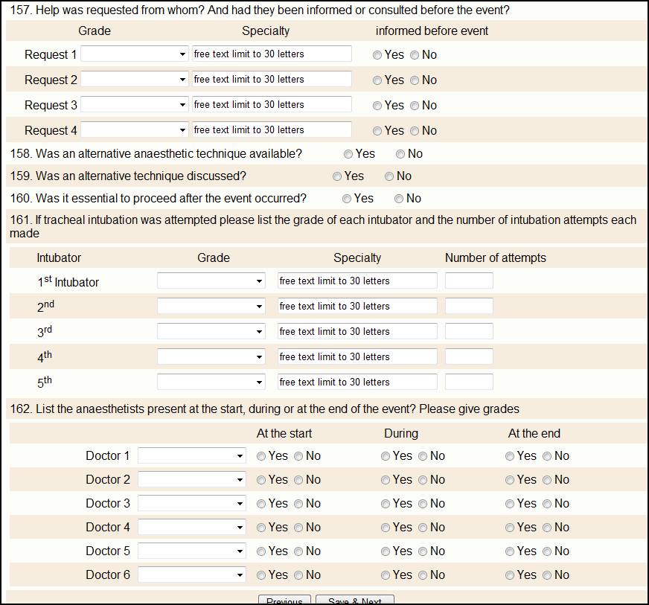

Slide 29
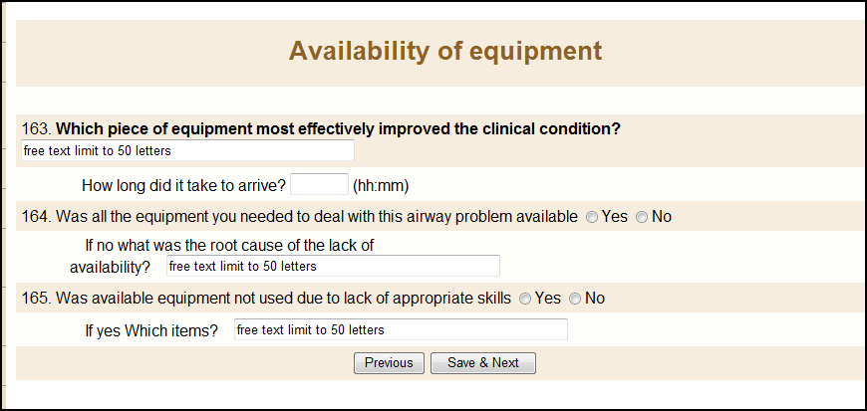

Slide 30
Anaesthesia
ED
ICU all separate forms

Slide 31
Airway Events
1st September 2008 – Jan 2010
287 cases submitted
75 via Ian Calder (43 referred for inclusion)
207 reviewed
*1 independent sector
1 out of dates

Slide 32




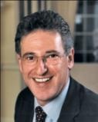



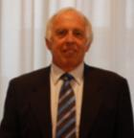




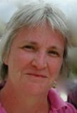



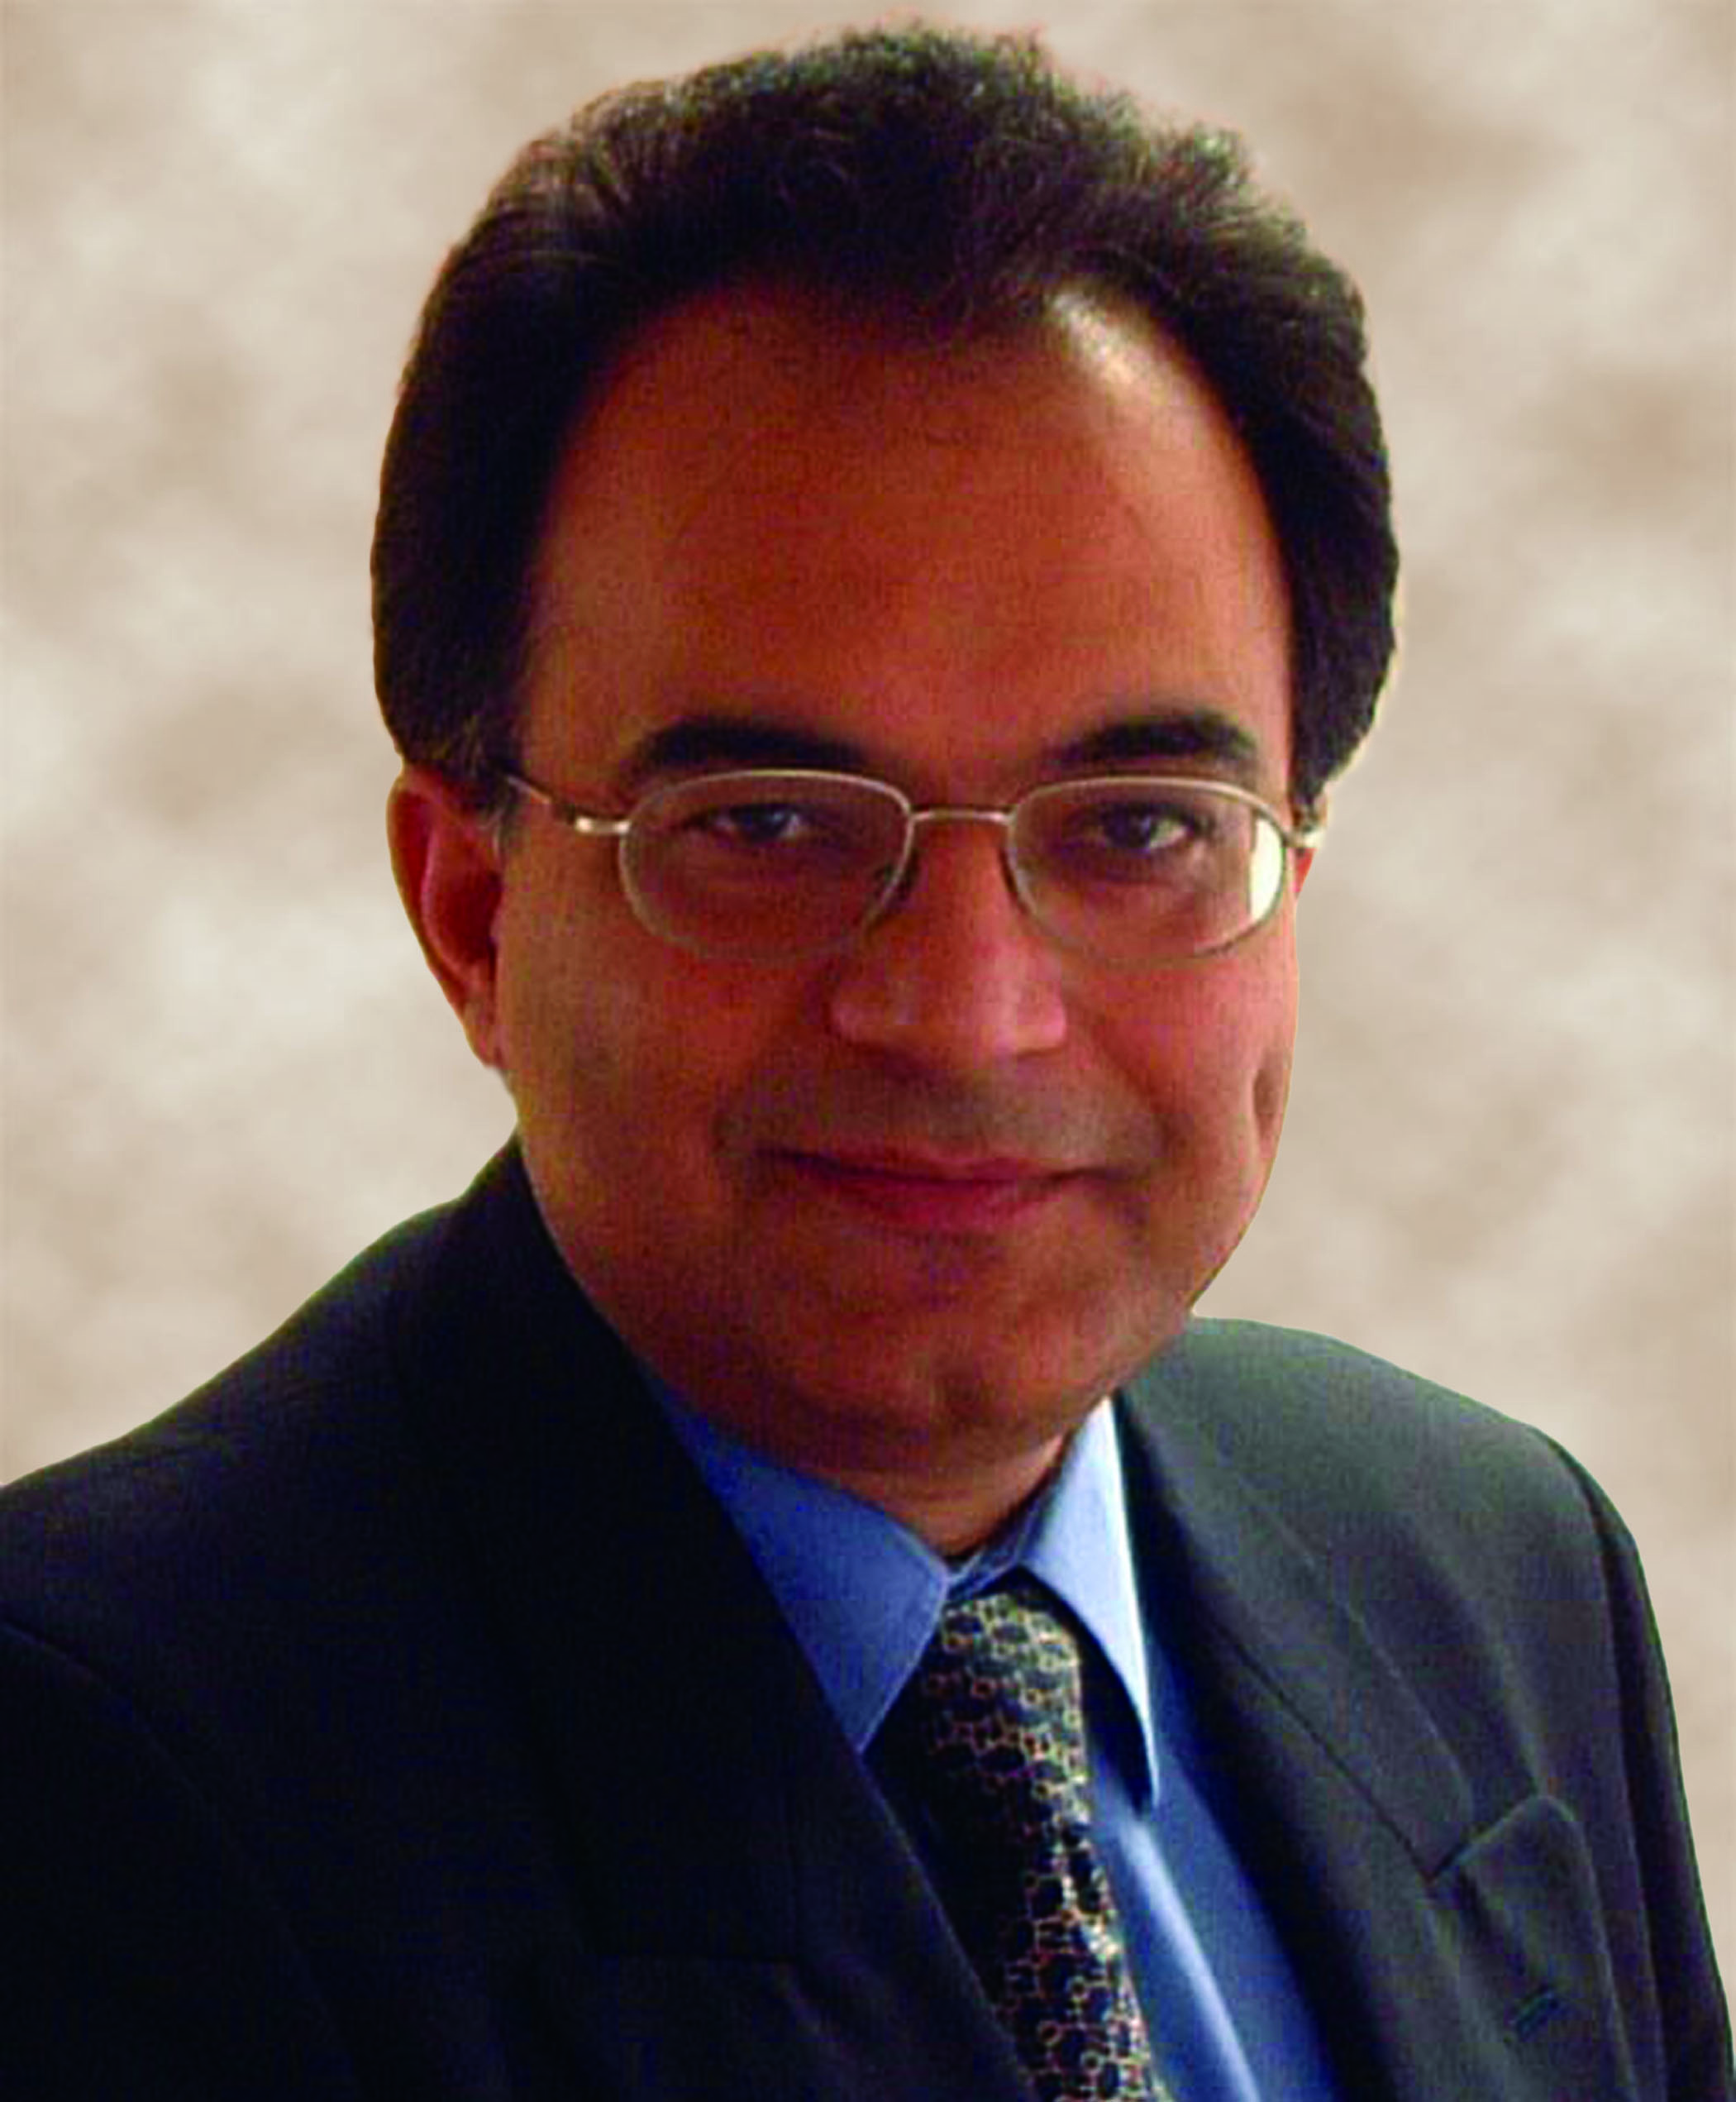
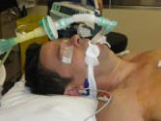

Review panel

Slide 33
Case Review Panel
21 members
Lay member
AfPP NPSA CODP College EM
DAS AAGB&I RCoA APA
OAA ICS Surgeons: ENT + MaxFax

Slide 34
Types of bias
Outcome
Hindsight
Group-think

Slide 35
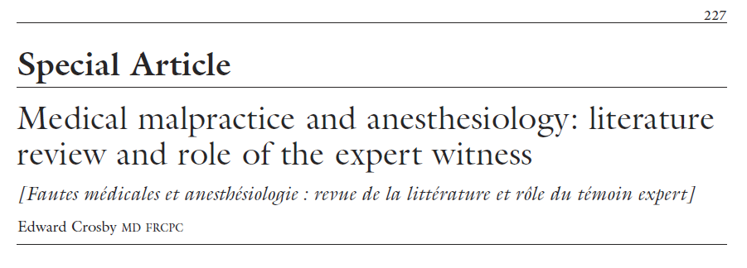

Review process

Slide 36
structured implicit review
team review
‘swapping over’ (peer re-review) [explores ‘between group disagreement’ to balance the tendency for ‘within group agreement’]
Reference to guidelines and recommendations but not constrained
Accepting and discussing disagreements, some of which we cannot resolve
expert exploration of the truth: not ‘the truth’

Slide 37
Case Review
Confirm case meets inclusion criteria
Evaluate the comprehensibility of report
Request additional information if essential
Grade final outcome and degree of harm
Categorise factors - causal
- contributory
- positive
Identify themes and illustrative cases

Slide 38
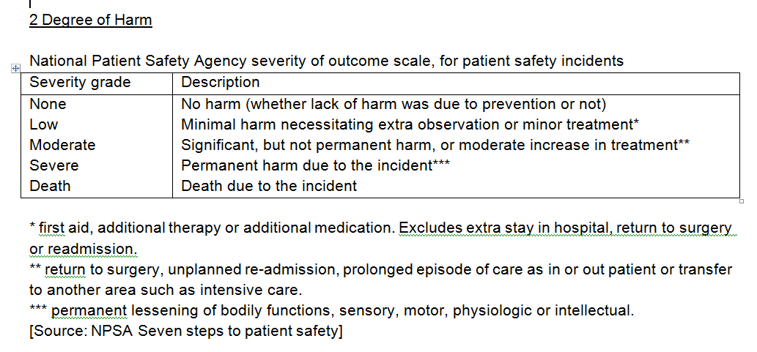
Case Review

Slide 39
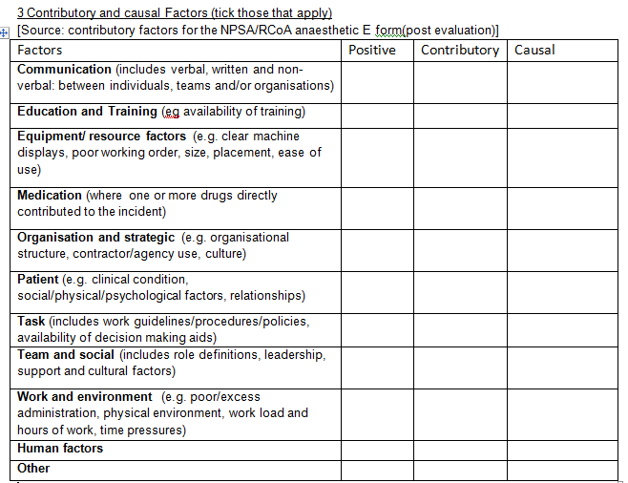
Review outputs
Inclusion?
Accuracy, consistency and clarity of data
Outcome
Contributory/causal/ positive factors
(based on NPSA classification)
Quality of airway managment
Comments
Each case reviewed by >5
Each ‘determiniation’ them moderated by opposite group

Slide 40
Review outputs
Inclusion
Accuracy, consistency and clarity of data
Outcome
Contributory/causal/ positive factors
(based on NPSA classification)
Quality of airway management
Comments
Each case reviewed by >5
Each ‘determination’ then moderated by opposite group

Slide 41
Phase 2: Airway Events
Did we get them all?

Slide 42
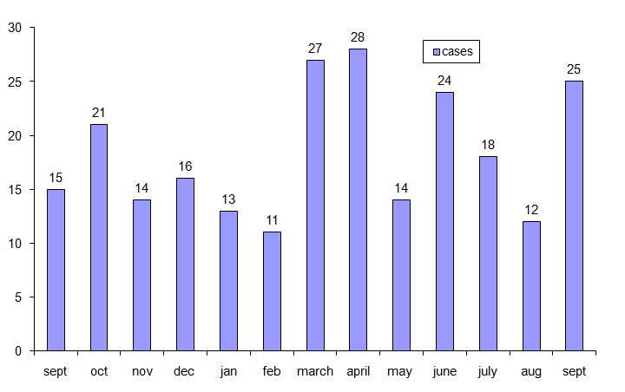
Temporal clusters
Median monthly reports 16
Median delay 13 days (iqr 5-37d, range 1-335)

Slide 43
Date of event

Slide 44
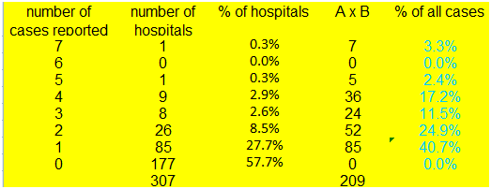
Hospital clusters
0.3% reported 3% of cases
0.6% reported 6% of cases
3.5% reported 23% of cases
6.1% reported 34% of cases
14.6% reported 60% of cases

Slide 45
Individual clustering
RCoA census
  6233 consultants
  12 600 anaesthetists
286 Local Reporters
  4.5% of consultants
  2.3% of all anaesthetists
5947 non LR consultants
12 314 non-LR anaesthetists

Slide 46
Anaesthesia reports (n=133)
  Other 111
  Both LR and involved in case 19
  Not specified 3
ICU reports (n=36)
  Both LR and involved in case 8
  Other 28
ED reports (n=16)
  Both LR and involved in case 4
  Other 12

Slide 47
Source of 131 ANAESTHESIA reports meeting criteria
CONS | non LR | LR
no report | 5837 | 265
report | 111 | 19
LRs 19 (15%)
Non-LRs 111 (85%)
Chi²
LRs significantly over-represented among
Consultants p=0.0001
All anaesthetists p=0.0001
ANAES | non LR | LR
no report | 12204 | 265
report | 111 | 19

Slide 48
Best estimate
It is possible that we got all cases
It is possible that we missed a substantial number......best estimate missed 3 in 4.

